Slide 1


Slide 2
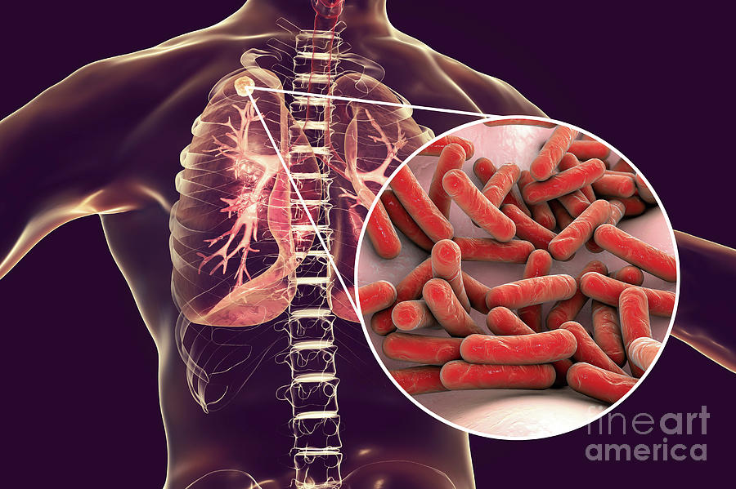
Tuberculosis
Presented by: Sushmita Gurung Roll no: 23 BNS 2nd years

Slide 3
General Objective
At the end of session BNS 1st year student will able to explain about Tuberculosis

Slide 4
Specific objectives
At the end of the teaching session, BNS 1st year students will be able to:
introduce tuberculosis
enlist causative agent and risk factors of tuberculosis
enlist mode of transmission of tuberculosis
explain pathophysiology of tuberculosis

Slide 5
Contd…
list the different clinical manifestations of tuberculosis.
state the different diagnostic tests to diagnosis tuberculosis
explain the medical and nursing management of tuberculosis.
list the complications of tuberculosis
state the preventive measure of tuberculosis.

Slide 6
Introduction
Tuberculosis is an infectious disease caused by mycobacterium tuberculosis, an aerobic acid-fast bacillus.
It primarily affects the lungs (Pulmonary Tuberculosis) although others areas such as kidney, liver, brain, lymph node and abdomen may be affected as well known as Extra Pulmonary Tuberculosis.

Slide 7
Epidemiology
World Health Organization report of 2022
10.6 million people become ill with tuberculosis in 2021,compared with 10.1 million in 2020.
1.6 million people died from tuberculosis in 2021 compared with 1.5 million in 2020.
6 million men, 3.4 million women and 1.2 million children

Slide 8
Nepal
117000 people are living in Nepal with Tuberculosis
69000 people developed Tuberculosis in 2018
The Tuberculosis incidence (new cases) was found to be higher (1.6 times) than previously thought.
The National Tuberculosis Prevalence Survey (TBPS) 2018-19

Slide 9
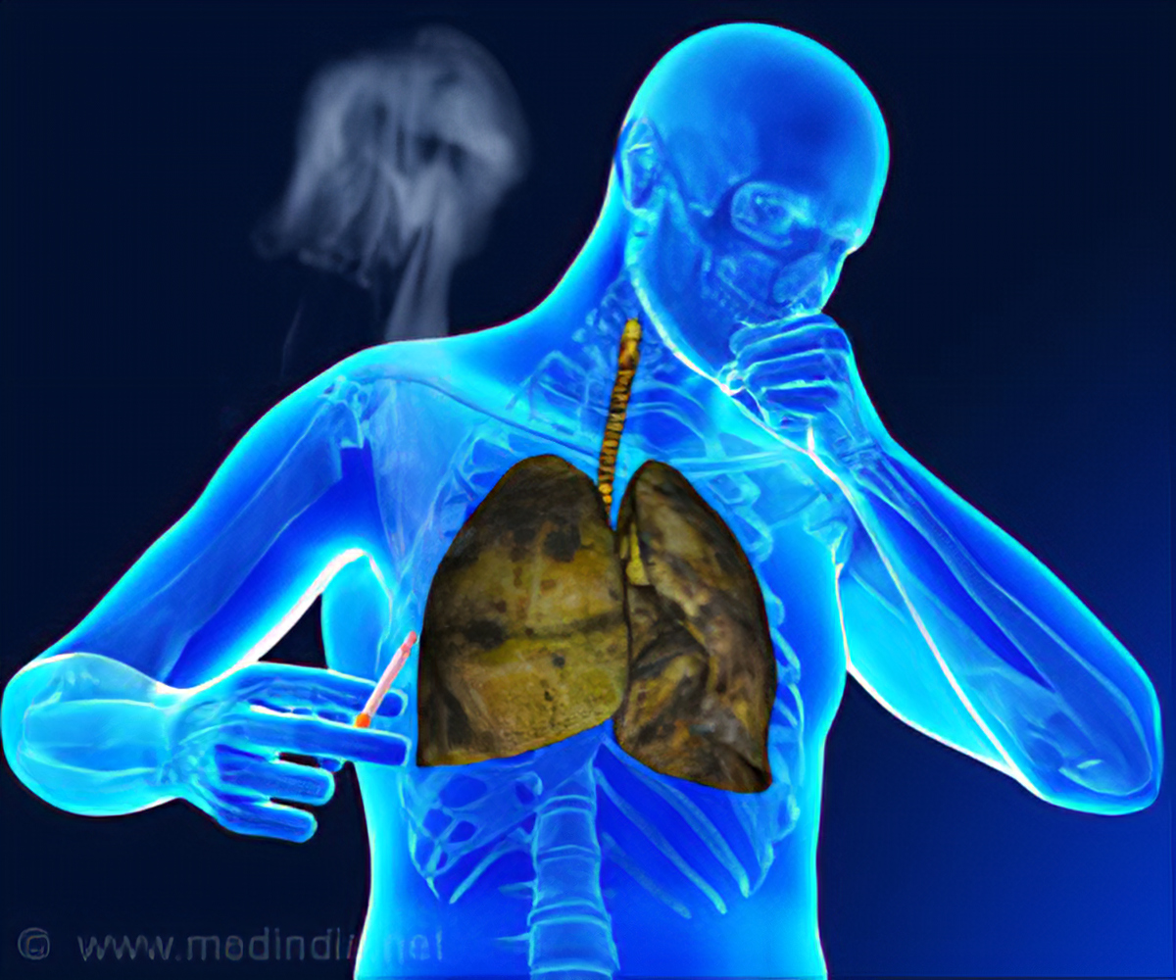
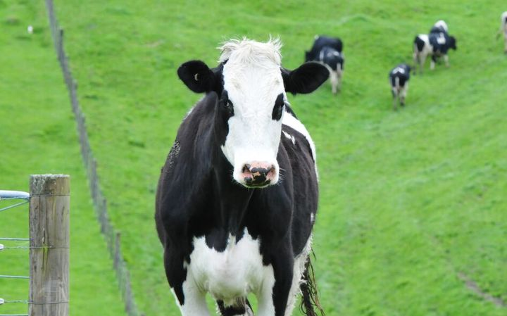
Causative agent
Mycobacterium tuberculosis Mycobacterium Bovis
(Human type) (Bovine type)

Slide 10
Risk factors
Genetic basis
Close contact with someone who has active TB.
Residence in overcrowded, substandard housing or institution (e.g. long term patients, psychiatric patients)
Immunocompromised status (e.g., HIV infection, cancer, transplanted organ and prolonged high-dose corticosteroid therapy
Patient with pre-existing medical condition including diabetes, chronic renal failure, silicosis and malnourishment

Slide 11
Contd of risk factors
Immigrants from other countries with high incidence of TB (Southeast Asia)
Lacking adequate health care (homeless, improvised, children)
Being health care worker performing high risk activities.
Substance abuse

Slide 12
Reasons for increasing incidence of Tuberculosis:
Developed countries | Developing countries
Immigration from high prevalence areas | 1. Ineffective control program
2. Human Immunodeficiency Virus (HIV) | 2. lack of access to health care
3. Social deprivation (homeless, poverty) | 3. Poverty, civil unrest
4. Drug resistance | 4. Drug resistance

Slide 13
Mode of transmission
Inhalation: TB is spread from person to person through the air. When people with lung TB cough, sneeze or spit, they propel the TB germs into the air. A person needs to inhale only a few of these germs to become infected
Ingestion: Self swallowing of the organism present in the infected sputum of an open case of pulmonary TB or ingestion of bovine tubercle bacilli from milk of diseased cows leads to the development of tonsillar or intestinal TB.

Slide 14
Contd of mode of transmission:
Inoculation: TB organism can get into the skin/tissue (rarely from sputum or post-mortem tissue)
Transplacental: Rare development of congenital TB in foetus from infected mother to foetus through the placental route.

Slide 15
Pathophysiology
Inhalation of mycobacterium tuberculosis
Body immune system responds by initiating an inflammatory process
Inhaled bacteria is phagocytosed by alveolar macrophages
Tissue reaction results in accumulation of exudated in alveoli causing bronchopneumonia

Slide 16
Inflammatory process and cellular reaction produces a small white nodules called primary tubercles
New tissue masses of live and dead bacilli are surrounded by macrophages
Transformed to fibrous centre of which is called Ghon’s tubercle
Materials becomes necrotic, forming a cheesy mass, may become calcified to collagenous scar.

Slide 17
Ghon’s tubercle ulcerate releasing cheesy materials.
Become airborne and spread slowly downwards to other parts of the lungs.

Slide 18
Spread of tuberculosis
Local spread
Lymphatic spread
Haematogenous spread

Slide 19
Incubation period
2-12 weeks, may remain latent for life.

Slide 20
Sign and Symptoms of tuberculosis

Slide 21
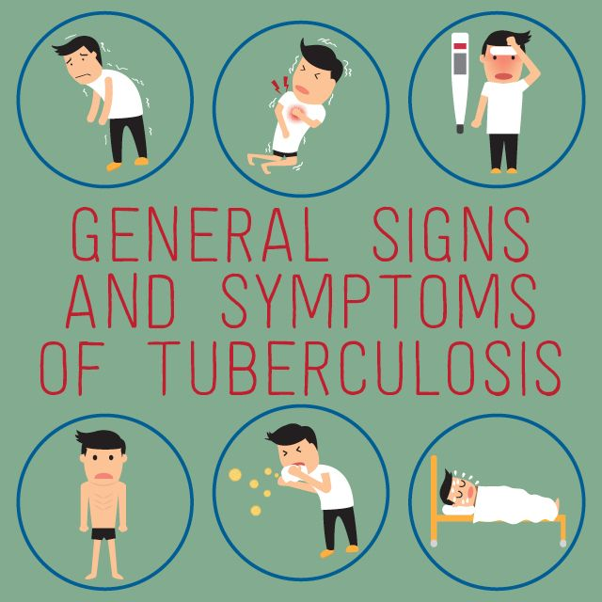

Slide 22
Pulmonary Symptoms
Productive or non-productive cough (>2weeks)
Dyspnoea and chest tightness
Chest pain characterized as dull or tight
Crackles may be present as auscultation
Purulent sputum production often with haemoptysis

Slide 23
Extra pulmonary tuberculosis symptoms
Persistently swollen glands
Abdominal pain
Pain and loss of movement in an affected bone or joint
Confusion
A persistent headache
Fits (seizures)

Slide 24
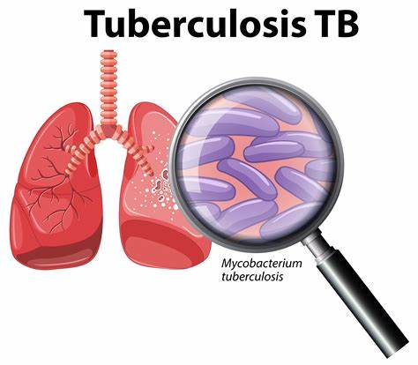

Slide 25
Diagnostic test
History Taking: age, sex, occupation, diet pattern, living condition, family history, personal habits, disease condition, medication, migrations etc.
Physical examination: body weight, BMI, vital signs, breath sounds, clubbing of fingers

Slide 26
Sputum culture, Gene xpert MTB/RIF
Serological test: Tuberculin test (Mantoux test)
Blood test: ESR, VDRL, TC, DC, HIV
Chest radiology : Chest Xray
Histo/cytopathological examination
CT scan or MRI

Slide 27


Slide 28
Medical management
Treatment of tuberculosis should be started immediately after confirmation of TB diagnosis. There is NO room for trial treatment.
For TB patients to be effectively treated, TB patients must be given the right drugs in the right combinations, appropriate dosage, administered correctly and regularly for the appropriate duration of time under observation.

Slide 29
Contd…..
The best way to ensure effective treatment for TB patients is to support medicine intake through Directly Observed Treatment, Short course (DOTS) using fixed-dose combination (FDC) tablets. All TB treatment must be given under DOT.

Slide 30
Table indicates the drugs and different durations of treatment
Type of Tuberculosis | Intensive phase | Continuation phase
New TB cases: Adult and childhood Bacteriological: or clinically diagnosed Pulmonary or extra-pulmonary | 2HRZE | 4HR
Complicated/severe EP cases (CNS TB, TB pericarditis, Miliary TB) | 2HRZE | 7-10 HRE

Slide 31
Retreatment cases All from: ^{1st Rapid} DST with Xpert MTB/RIF testing should be done to see the status of resistance to Rifampicin Followed by LPA among those having MTB+ve and Rifampicin sensitive for Isoniazid (INH) resistance status. | Xpert: MTB/RIF –Rifampicin sensitive LPA –Isoniazid sensitive Xpert MTB/RIF – Rifampicin sensitive LPA- Isoniazid Resistant and FQ sensitive | 2HRZE 4HR 6 (H)RZE + Levofloxacin (full duration)

Slide 32
 | Xpert MTB/RIF-Rifampicin sensitive LPA- Isoniazid not known because of no access to LPA Rifampicin sensitive INH Resistance and FQ resistant | 6HRZE (full duration) 6(H)RZE
DR TB | Refer to national Guidelines on DR-TB management (2019)

Slide 33
The commonest DR/MDR-TB regimen used in Nepal are:
Shorter Standardized Treatment Regimen (SSTR)
The STR consists of an intensive phase of 4 months with 7 drugs, followed by a continuation phase of 5 months with 4 drugs.
The intensive phase will be extended if smear conversion is not achieved within 4 months, with a maximum of 6 months.

Slide 34
Drugs | Intensive phase 4(+1 or 2) months | Continuation phase 5 months (fixed)
Amikacin
Ethionamide
Isoniazid high dose
Moxifloxacin high dose
Clofazimine
Pyrazinamide
Ethambutol

Slide 35
Longer Regimen 1:
Initiated if non-eligible for SSTR: Total 18 months
Bedaquiline (Bdq) | 6 months
Levofloxacin (Lfx)
Linezolid (Lzd)
Clofazimine (Cfz)
Pyrazinamide (Z)
18 months

Slide 36
Longer regimen 2:
If resistant to Fluoroquinolones (FQs)/ risk of FQ resistance /XDR TB will be started with following regimen
Bedaquiline (Bdq) | 12 months
Lenezolide (Lzd)
Clofazimine (Cfz)
Cycloserine (Cs)
Pyrazinamide (Z)
18 months

Slide 37
Complication of tuberculosis
Pneumothorax
TB Pneumonia
Bronchiectasis
Tubercular meningitis
Miliary tuberculosis
Pleurisy and pleural effusion
Corpulmonale
HIV related opportunistic infections

Slide 38
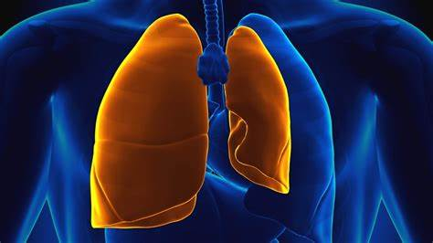
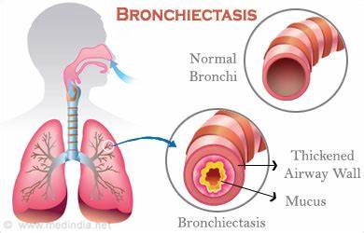
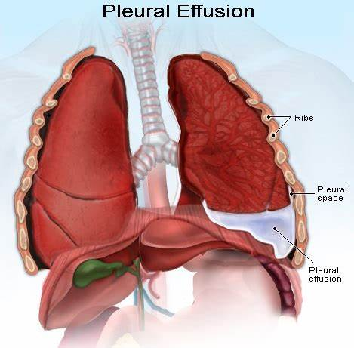
Complication
Pneumothorax

Slide 39

Nursing management

Slide 40
Assessment
Complete history taking and physical examination
Clinical manifestation of fever, weight loss, anorexia, night sweats, fatigue, cough and sputum production prompt and more through assessment of respiratory function
Assessing lungs for consolidation by evaluating breathe sounds (diminished bronchial sounds, crackles)

Slide 41
Contd…
Observe dietary pattern
Reconsider special recommendation and activity level

Slide 42
Nursing Diagnosis
Ineffective airway clearance related to copious trachea- bronchial secretions.
Hyperthermia related to infectious process.
Activity in tolerance related to fatigue, altered nutritional status and fever.

Slide 43
Contd…
Altered nutrition less than body requirements related to anorexia, fever, severity of illness , mental confusion.
Anxiety related to deficient knowledge about treatment regimen and preventive health measures.

Slide 44
Nursing Intervention
Ineffective airway clearance:
Monitor the breathing sound for the presence of crackles or wheeze and amount, colour and consistency of the sputum.
Turn patient 2 hourly if bed ridden or encourage to ambulate if able.
Provide nebulization as needed.
Obtain order for chest physiotherapy.
Increase fluid intake promotes systemic hydration and serves as an
effective expectorant.

Slide 45
Hyperthermia
Assess and monitor the patient’s condition, vital signs including temperature, pulse, respiration the condition of mucus membrane.
Adjust environmental factor and remove heavy blankets and clothes and maintain ventilation in room
Apply tepid water sponging for about 20-30 minutes
Encourage patient to increase fluid intake equal to his /her urine
output
Provide adequate diet to anticipate the increase need during disease.

Slide 46
Imbalanced nutrition
Document patient’s nutritional status on admission, noting the skin turgor, current weight and degree of weight loss, integrity of oral mucosa ability or inability to swallow, presence of bowel tone, history of nausea and vomiting or diarrhoea.
Monitor and manage patient’s usual dietary pattern including selection of diet.
Provide oral care before and after respiratory treatments.
Encourage small, frequent meals with foods high in protein and carbohydrates.

Slide 47
Contd of imbalanced nutrition
If there is persisting nausea and vomiting , then administer anti- emetics and antacid as per prescription
Monitor laboratory studies: BUN, Serum and Albumin.

Slide 48
Deficient knowledge about preventive measures
Milk parturition and milk boiling, do not take raw milk.
Well ventilated room
Protection against exposure to TB
Use mask for preventing droplet enter into the lungs
Give BCG vaccine to all children to prevent tuberculosis.

Slide 49
Prevention of malnutrition.
Promote environmental sanitation, reduce overcrowded.
Sputum disposes properly, use sputum pots with lids, covering the mouth with hands when coughing and sneezing.

Slide 50
Prevention
BCG vaccination
Build well ventilated house
Have nutritious diet to improve immunity
Cover mouth with mask
Isolation of infected person

Slide 51
Contd….
Finish entire course of medication
Mass awareness programme should be implemented.
Avoid over crowded areas
Immunization for adult while travelling to endemic area

Slide 52


Slide 53
References
Black, J. M., & Hawks, J., H., (2009), Medical surgical nursing volume 2,
8th edition, Saunders Elsevier, Pp- 1604-1606.
Burke,k., & lemone,p.,(), Medical Surgical nursing, 4thedition,Elsevier, PP
1210-1212.
Hinkle,J., L., & Cheever, K., H., (2015), Brunner and Suddarth’s textbook of
medical surgical nursing, volume 1, 13th edition, Wolters Kluwer, Asian pg: 586-592.
Harsh M, (2010), Textbook of pathology, 6th edition, Jaypee brothers. Pp: 149- -152.

Slide 54
Contd…
https://www.who.int/nepal/news/detail/24-03-2020-nepal-completes-first-national-tuberculosis-prevalence-survey-another-step-towards-endtb
Mandal, G., N.,( 2013),A textbook of Adult nursing, 2nd edition, Makalu publication house, Pp 160-163.
Williams, L., S., & Hopper, P., D., (2015), Understanding medical surgical nursing, 5th edition, Jaypee brothers, Pp 646-652
(2019), National tuberculosis management guidelines 2019,Nepal.

Slide 55
Summary

Slide 56
Question
Fill in the blanks:
Causative agent of tuberculosis is ______.
Mantoux test is the diagnostic test of _______.
Choose the correct one:
The full form of DOTS is :
Directly Observed Transient Short course
Directly Observed Treatment, Short course
Directly Observed The Short course

Slide 57
Home assignment
Define Tuberculosis. List out risk factors and mode of transmission of tuberculosis.
Explain the medical and nursing management of tuberculosis.

Slide 58
Plan for next class
We will discuss about sub-fertility in our next class

Slide 59


